Slide 1
Network Protocols
tbulega@cis.mak.ac.ug
bernard.muwonge@mak.ac.ug
Notes:
Cisco Networking Academy program
Network Basics
Chapter 3: Network Protocols and Communications

Slide 2
Network Standards
Definitions and concepts
Message ordering and reliability
Semantics and syntax
Encoding application messages
Vertical communication on the source host
Standards architectures
Notes:
We’ll begin by talking about some standards definitions and standards concepts.

Slide 3
Standards
Standards allow different systems to work together.
The terms “standard” and “protocol” mean the same thing.
Standardized
Communication
A
B
Notes:
Just read the text.
Then show the diagram.

Slide 4
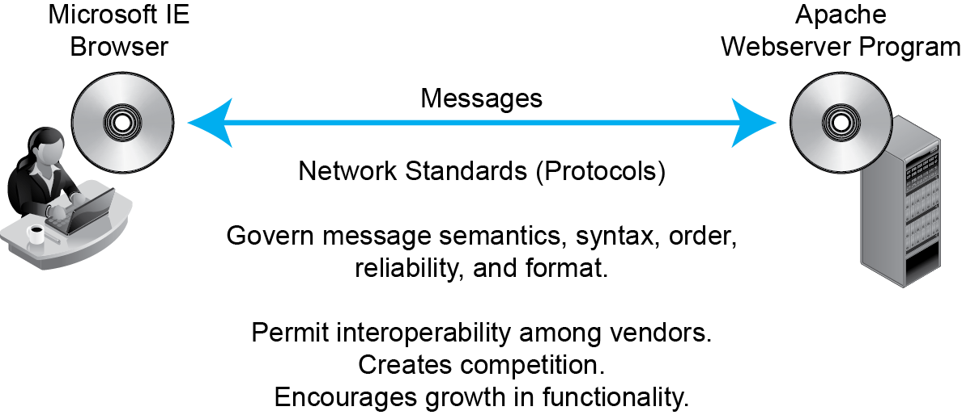
Network Standards
Notes:
Just to through the figure from top to bottom.

Slide 5
Layers
Recap from Chapter 1
Broad Function | Layer Number | Layer Name
Interoperability of application programs | 5 | Application
Transmission across an internet | 4 | Transport
 | 3 | Internet
Transmission across a single switched or wireless network | 2 | Data Link
 | 1 | Physical
Notes:
Recap this figure, describing how the layers are interrelated.

Slide 6
Network Standards Concepts
Network Standards
Network standards are rules that govern the exchange of messages between hardware or software processes on different hosts, including messages (ordering, semantics, and syntax), reliability, and connection orientation.
What are ordering, semantics, and syntax?
Notes:
Read the text.
Emphasize that students must learn this definition.
The last point is rhetorical. We will see what they are.

Slide 7
Network Standards
Definitions and concepts
Message ordering and reliability
Semantics and syntax
Encoding application messages
Vertical communication on the source host
Standards architectures

Slide 8
Network Standards Concepts
Message Order
Turn taking (think of telephone conversations)
Order of messages in an ATM withdrawal
Who must initiate communication, and so on
Reliability
A reliable protocol both detects and corrects errors during transmission.
Error detection alone is not enough.
Many unreliable protocols detect errors but then merely drop incorrect messages without correcting them
Notes:
Read the text.
Give emphasis.

Slide 9
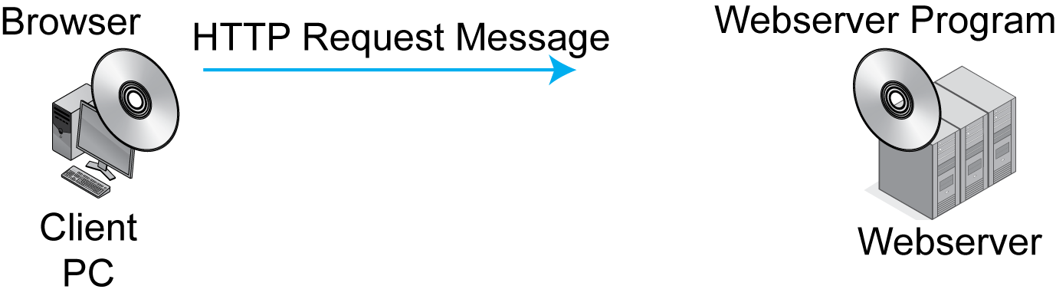
Network Standards Concepts
Message Order in HTTP
In HTTP, the client program initiates the communication by sending an HTTP request message.
Notes:
Read the text.
Then go through the illustration.

Slide 10
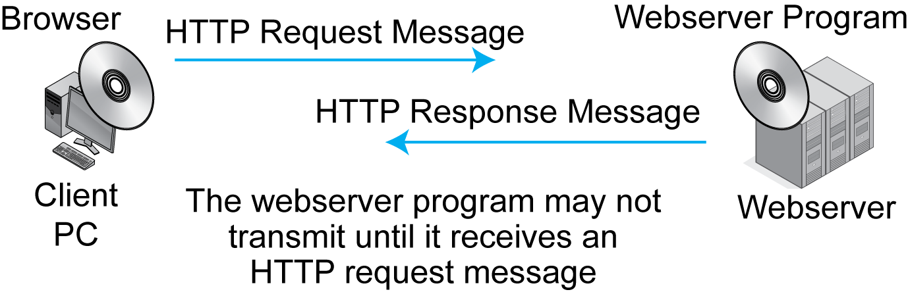
Network Standards Concepts
Message Order in HTTP
Notes:
Go through the illustration from left to right.

Slide 11
Network Standards Concepts
Reflection: Message Order in HTTP
The client must initiate the interaction.
Other network standards have more complex turn taking; for instance TCP.
Human turn taking is loose and flexible.
But message order for network standards must be rigid because computers are not intelligent.
TCP exemplifies more complex message ordering.
Notes:
Read the text.

Slide 12
A Connection
HTTP is connectionless.
Every request–response cycle is independent.
There is no connection between request/response cycle
TCP is connection-oriented.
There is a formal opening of the connection.
Within the connection, messages are sequenced, acknowledged, and retransmitted if necessary.
There is a formal closing of the connection.
Q: What is connection oriented? E-mail? Telephone conversations?
Notes:
Read the text.

Slide 13
Chapter 2: Network Standards
Definitions and concepts
Message ordering and reliability
Semantics and syntax
Encoding application messages
Vertical communication on the source host
Standards architectures

Slide 14
Network Standards Concepts
Message Semantics
Semantics is the meaning of a message.
HTTP request message: “Please give me this file.”
HTTP response message: “Here is the file. (Or, I could not comply for the following reason …)”
Notes:
Read the text.

Slide 15
Network Standards Concepts
Message Semantics
Network standards normally have a very limited set of possible message meanings.
For example, HTTP requests have only a few possible meanings.
GET: Please give me a file.
PUT: Store this file (not often used).
A few more.
Notes:
Read the text.

Slide 16
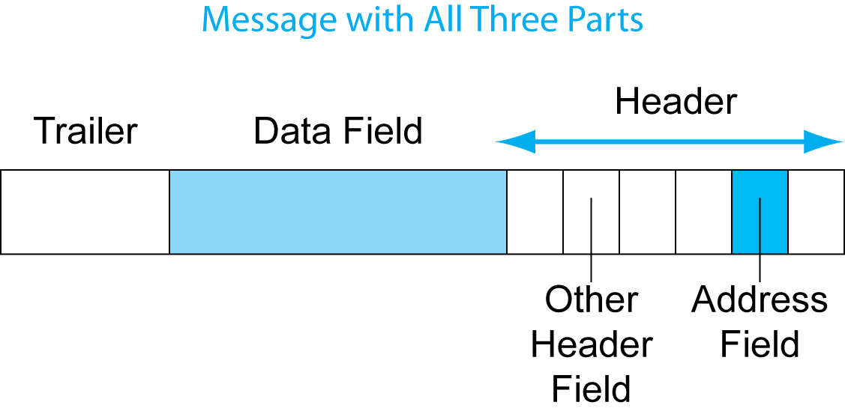
General Message Organization
Message Syntax: Message Layout
Like human grammar, but more rigid.
In general, messages may have three parts.
3
2
1
Notes:
Read the text.
Go through the three parts.
Emphasize that this is something that students will see throughout the book.

Slide 17
General Message Organization
Message Syntax
The data field contains the content being delivered.
The header is everything before the data field.
The trailer is everything after the data field.
Notes:
Read the text.
Note how simple the definitions of the header and trailer are.
Go through the illustration.

Slide 18
General Message Organization
Message Syntax
The header is broken into smaller sections called header fields.
There often is a destination address header field to indicate where to deliver the message.
Notes:
Read the text.
Go through the illustration.

Slide 19
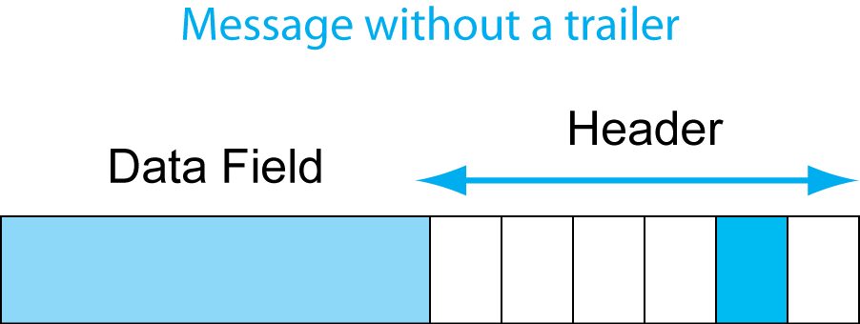
General Message Organization
Most Messages Do Not Have Trailers.
Notes:
Read the text.
Go through the illustration.

Slide 20
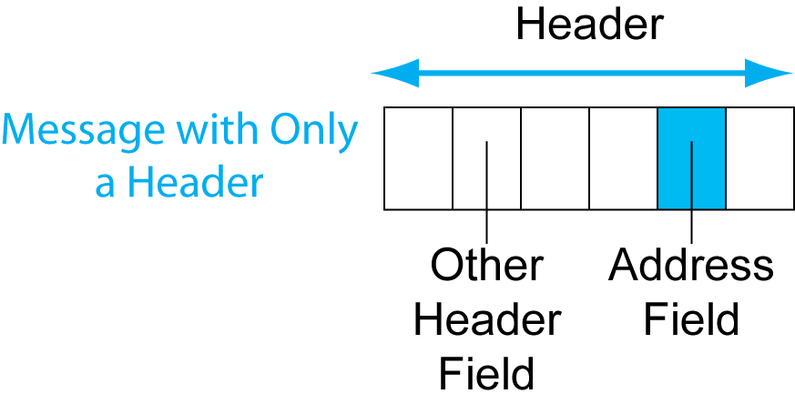
General Message Organization
Some messages do not have data fields.
Example: TCP SYN segments have only headers.
Notes:
Read the text.
Go over the illustration.

Slide 21
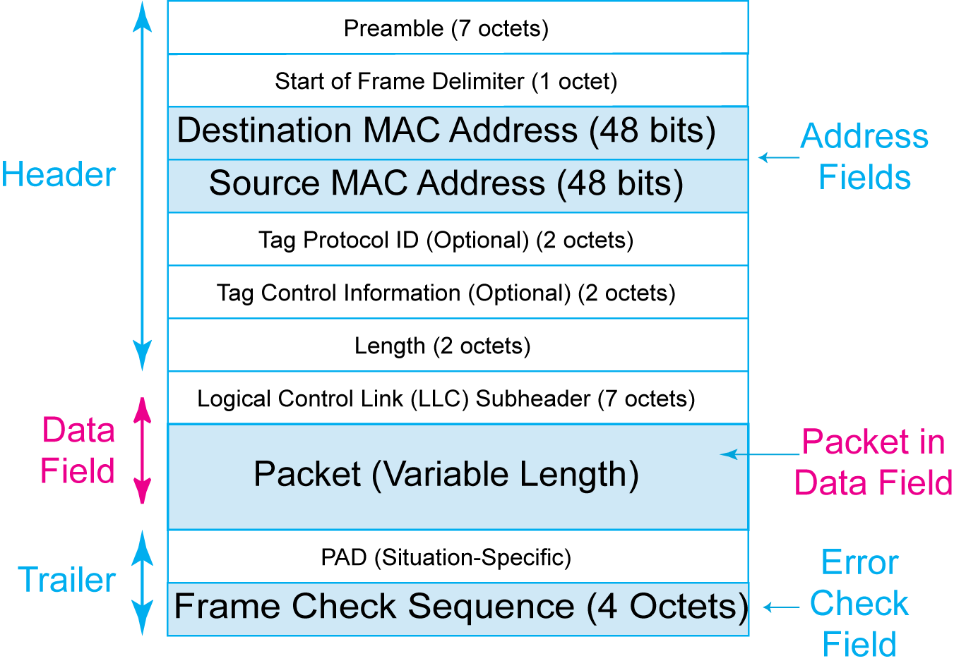
Example: Ethernet Frame
The Ethernet frame has a header, data field, and trailer. The header has multiple fields.
Notes:
Read the text.
Go over the illustration.

Slide 22
Example: Ethernet Frame
The Ethernet data field contains the packet that the frame is delivering.
Notes:
Read the text.
Go over the illustration.

Slide 23
Example: Ethernet Frame
The trailer contains the
Frame Check Sequence field for error detection.
The sender computes the value based on all bits.
The receiver redoes the calculation.
If the receiver gets a different value,
it discards the frame.
There is no error correction.
Ethernet is not reliable.
Notes:
Read the text.
Go over the illustration.

Slide 24

Perspective: Syntax
Every message is a long stream of bits.
Headers and trailers are determined by bit position
TCP or UDP
Header
IP
Header
Ethernet
Header
1101000101101101000101101101000101101011010001011010110100010110
Notes:
Read the text.
This is a key figure in getting students to keep straight what they have been learning.

Slide 25
Network Standards
Definitions and concepts
Message ordering and reliability
Semantics and syntax
Encoding application messages
Vertical communication on the source host
Standards architectures
Notes:
(Note: this is very difficult for students. I’ve cut it down in this edition.)

Slide 26
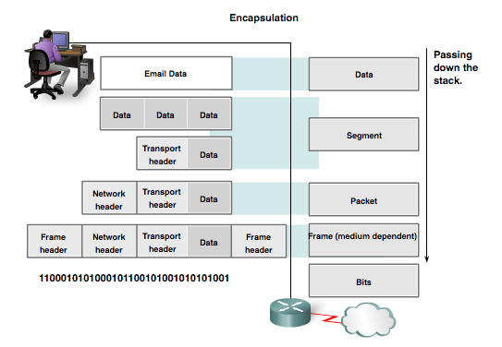
Data Encapsulation Protocol Data Units
Data Encapsulation is the process in which some extra information is added to the data item to add some features to it.
Data
Segment
Packet
Frame
Bits
Notes:
3.3.1.3 Protocol Data Units (PDUs) – A unit delivered as a unit with peers; information added or removed; Unit of data with headers and trailers
Apply encapsulation or de-encapsulation → PDU

Slide 27
Data Encapsulation
The data is encapsulated on the sender’s side, starting from the application layer to the physical layer.
Each layer takes the encapsulated data from the previous layer and adds some more information to encapsulate it and some more functionalities with the data.
These functionalities may include proper data sequencing, error detection and control, flow control, congestion control, routing information, etc.

Slide 28
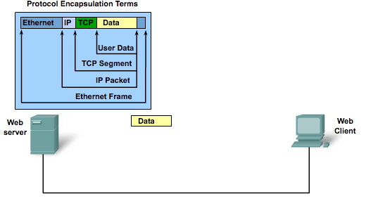
Data Encapsulation Encapsulation
Notes:
3.3.1.4 Encapsulation

Slide 29
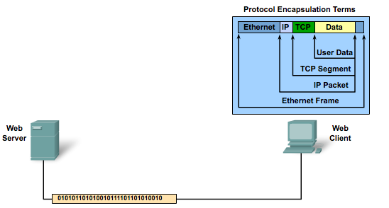
Data Encapsulation De-Encapsulation
Notes:
3.3.1.5 De-encapsulation

Slide 30
Data De-encapsulation
It is the reverse process of data encapsulation.
The encapsulated information is removed from the received data to obtain the original data.
This process takes place at the receiver’s end.
The data is de-encapsulated at the same layer at the receiver’s end to the encapsulated layer at sender’s end.
The added header and trailer information are removed from the data in this process.

Slide 31
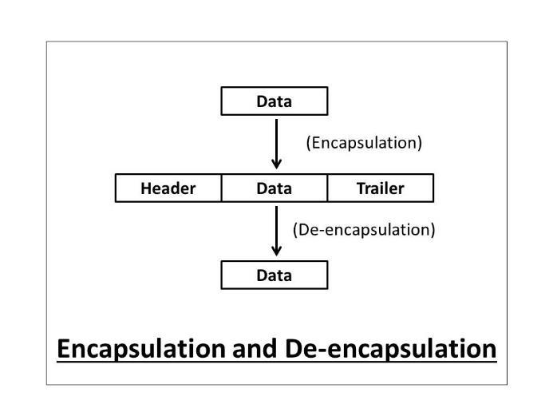
The diagram shows how the header and footer are added and removed from the data in the process of encapsulation and de-encapsulation respectively.

Slide 32
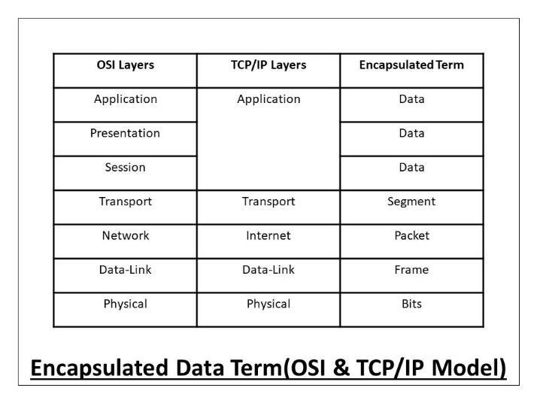
The data is encapsulated in every layer at the sender’s side and also de-encapsulated in the same layer at the receiver’s end of the OSI or TCP/IP model.

Slide 33
Encapsulation Process (Sender’s side)
Step 1: The Application, Presentation, and Session layer (OSI model), or Application layer (TCP/IP model) takes the user data in form of data streams, encapsulates it and forwards the data to the Transport layer.
Step 2: Transport layer takes the data stream from upper layers, and divide it into multiple pieces. It encapsulates the data by adding the appropriate header to each piece, (now data segments). The header contains the sequencing information so that the data segments can be reassembled at the receiver’s end.
Step 3: The Network layer (OSI model) or Internet layer (TCP/IP model) takes these data segments and encapsulate them by adding an additional header to them. This data header contains all routing information for proper delivery of data. These are now data packets or datagrams.

Slide 34
Step 4: The Data-Link layer takes the data packet from the Network layer and encapsulate it by adding an additional header and footer to it.
The header contains all the switching information for the proper delivery of the data to the appropriate hardware components, and the trailer contains all the information related to error detection and control.
Step 5: The Physical layer takes the data frames from the Data-Link layer and encapsulate them by converting them to appropriate data signals or bits (corresponding to the physical medium)

Slide 35
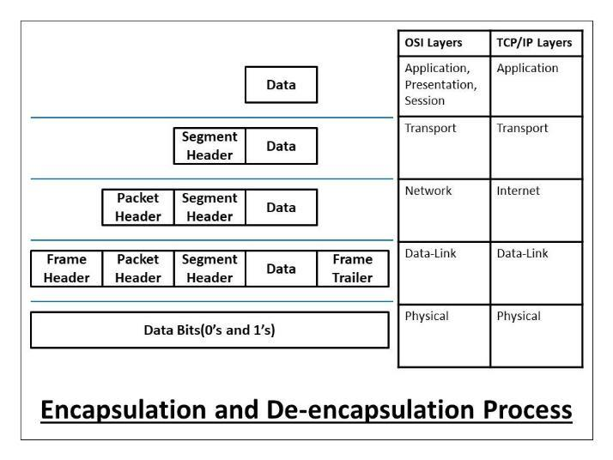

Slide 36
De-Encapsulation Process (Receiver’s side)
Step 1: The Physical layer takes the encapsulated data signals or bits from the sender, and de-encapsulate it in the form of a data frame to be forwarded to the upper layer – data link layer.
Step 2: The Data-Link layer takes the data frames from the Physical layer. It de-encapsulates the data frames and checks the frame header whether the data frame is switched to the correct hardware or not.
If the frame is switched to the incorrect destination, it is discarded, else it checks the trailer information. If there is any error in the data, a retransmission is requested, else it is de-encapsulated and the data packet forwarded to upper layer.

Slide 37
Step 3: The Network layer (OSI) or Internet layer (TCP/IP) takes the data packet from Data-Link layer. It de-encapsulates the data packets and checks the packet header whether the packet is routed to the correct destination or not.
If the packet is routed to the incorrect destination, the packet is discarded, else it is de-encapsulated and the data segment is forwarded to the upper layer.
Step 4: The Transport layer takes the data segments from the network layer and de-encapsulate it. It first checks the segment header and then reassembles the data segments to form data streams, and these data streams are then forwarded to the upper layer.
Step 5: The Application, Presentation, and Session layer (OSI model), (Application layer in TCP/IP) takes encapsulated data from Transport layer, de-encapsulate it, and application-specific data is forwarded to applications.

Slide 38
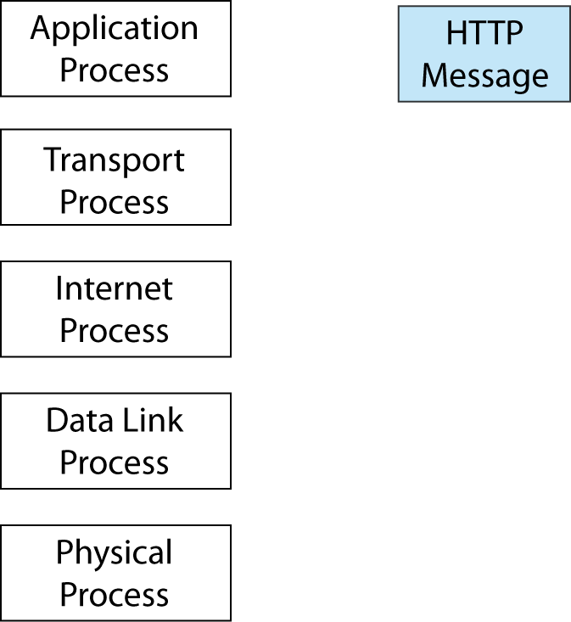
Source Host
The application process creates an application message for the application process on the destination host.
In this case, the application process is a browser.
Notes:
Go through the details.

Slide 39
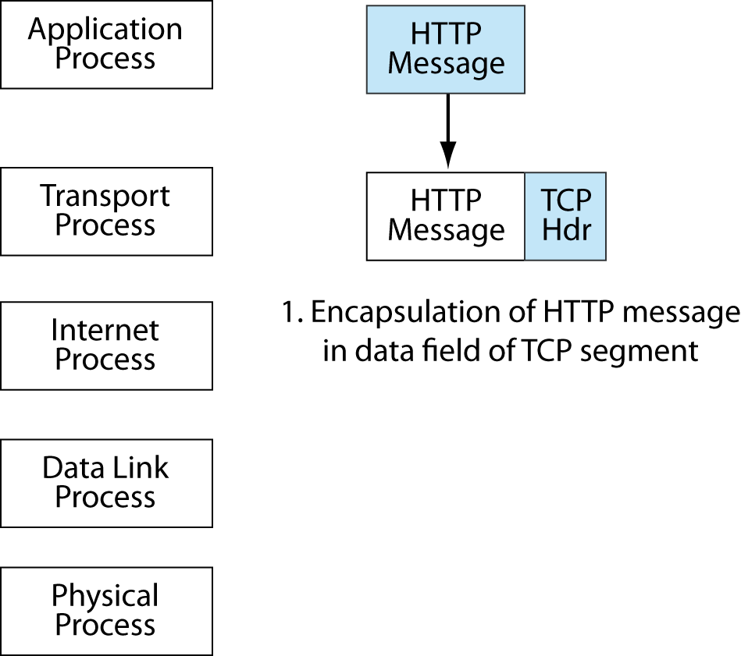
Source Host
The application process passes the HTTP message down to the transport layer process.
The transport process encapsulates the HTTP message in the data field of TCP segment.
This requires adding a TCP header.
Notes:
Read the text.
Then go through the details.

Slide 40
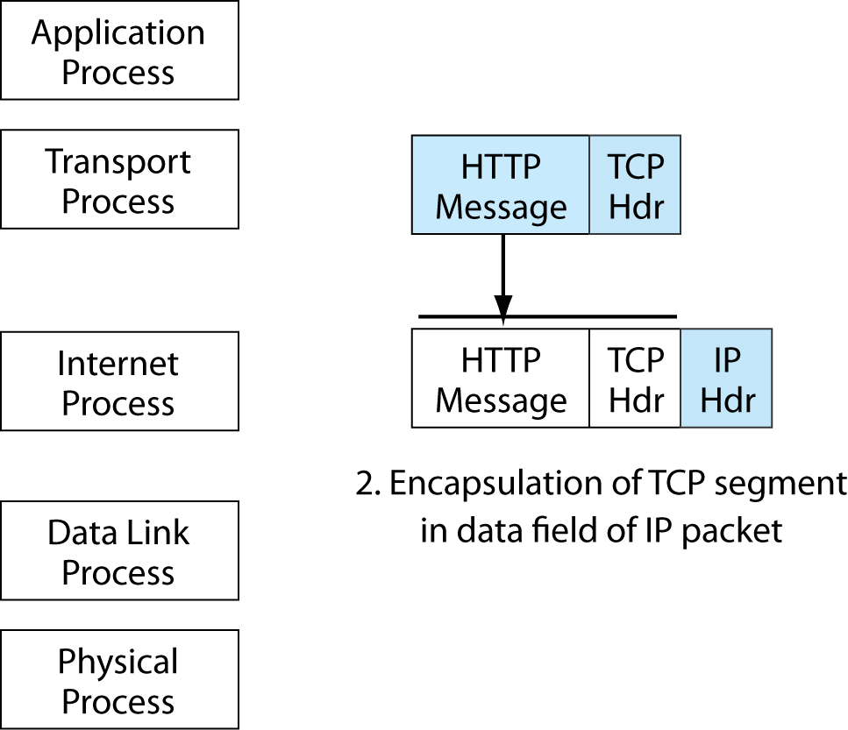
Source Host
The transport process passes the TCP segment down to the internet process, which encapsulates the segment in an IP packet.
Notes:
Read the text.
Then go through the details.

Slide 41
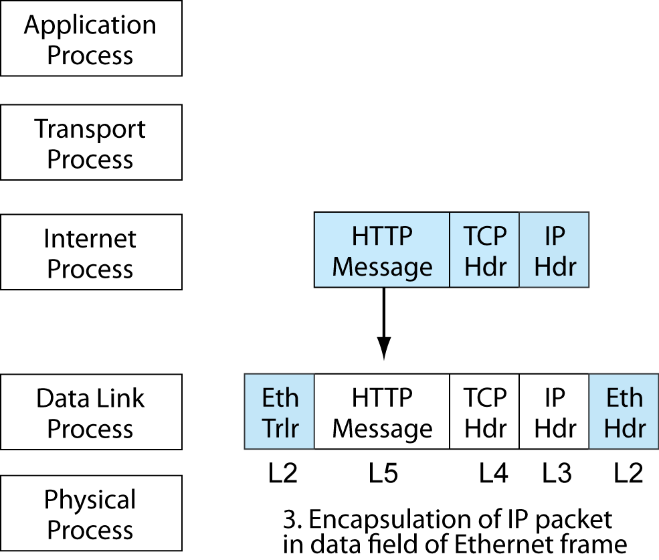
Source Host
The internet process passes the IP packet to the data link process, which is Ethernet.
Ethernet adds a header and trailer.
Notes:
Read the text.
Then go through the details.

Slide 42
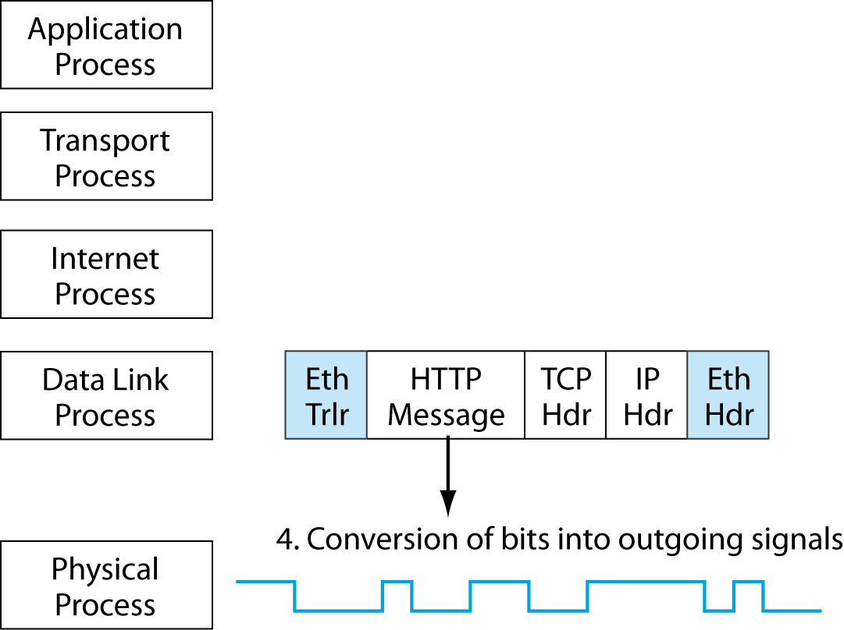
Source Host
The data link process passes the frame down to the physical layer.
The physical layer does NOT do encapsulation. It merely converts the bits of the frame into signals.
Notes:
Read the text.
Then go through the details.

Slide 43
Vertical Communication on the Source Host
The application, transport, internet, and data link layer process do the same thing.
Create a message in all but the originating layer (in this case, application) by encapsulation.
Then pass the message down to the next lower layer.
The physical layer process is different.
It merely converts the bits of the frame into signals.
Notes:
Read the text.

Slide 44
Network Standards
Definitions and concepts
Message ordering and reliability
Semantics and syntax
Encoding application messages
Vertical communication on the source host
Standards architectures

Slide 45
Major Standards Architectures
To build a house, you do not build one room, then decide what to do next.
You create an architecture identifying the rooms that will be needed and how the rooms will relate to one another in terms of flow.
Then you begin the design of individual rooms.
Notes:
Read the text.

Slide 46
Major Standards Architectures
In networking, standards agencies first create standards architectures that define the categories of standards to be developed.
They define these categories in terms of layers.
They then design standards for the individual categories.
Notes:
Read the text.

Slide 47
Major Standards Architectures
There are two major standards architectures.
TCP/IP
This is the standards architecture for the Internet and many corporate internets.
Its standards agency is the Internet Engineering Task Force (IETF).
As we saw in Chapter 1, most of its documents are called requests for comment (RFCs).
Some (but not all) RFCs are official Internet standards.
Notes:
Read the text.

Slide 48

Major Standards Architectures
OSI
Its two standards agency are ISO and the ITU-T.
ISO (the International Organization for Standardization) is a computer standards agency.
The ITU-T is the International Telecommunications Union—Transmission Standards Agency.
Don’t confuse ISO the organization with OSI the architecture.
Notes:
Read the text.

Slide 49
Major Standards Architectures
OSI divides standards into seven layers:
Broad Purpose | OSI Layers
Application communication | Application (Layer 7)
 | Presentation (Layer 6)
 | Session (Layer 5)
Internetworking | Transport (Layer 4)
 | Network (Layer 3)
Communications within a single LAN or WAN | Data Link (Layer 2)
 | Physical (Layer 1)
Notes:
Go through the figure.

Slide 50

Major Standards Architectures
OSI divided application communication into three layers
Session (5) creates a managed session between applications. If there is a break in communication, the communication has only to go back to the last roll-back point.
Presentation (6) was designed to translate between data formats on different computers. In practice, it is actually used as a category for file format standards, such as jpg and mp3.
Application (7) handles other details of application communication.
Notes:
Read the text.

Slide 51
Major Standards Architectures
TCP/IP divides standards into four layers.
Broad Purpose | TCP/IP
Applications | Application
Internetworking | Transport
 | Internet
Communication within a single LAN or WAN | The IETF assumes that OSI standards will be used at the Physical and Data Link Layers
Notes:
Go through the figure.

Slide 52
Summary
In this chapter, you learned:
Data networks are systems of end devices, intermediary devices, and the media connecting the devices. For communication to occur, these devices must know how to communicate.
These devices must comply with communication rules and protocols. TCP/IP is an example of a protocol suite.
Most protocols are created by a standards organization, such as IETF or IEEE.
The most widely-used networking models are OSI and TCP/IP.
Data that passes down the stack of the OSI model is segmented into pieces and encapsulated with addresses and other labels. The process is reversed as the pieces are de-encapsulated and passed up the destination protocol stack.
Notes:
Chapter 3 Summary

Slide 53
In this chapter, you learned:
The OSI model describes the processes of encoding, formatting, segmenting, and encapsulating data for transmission over the network.
The TCP/IP protocol suite is an open standard protocol that has been endorsed by the networking industry and ratified, or approved, by a standards organization.
The Internet Protocol Suite is a suite of protocols required for transmitting and receiving information using the Internet.
PDUs are named according to the protocols of the TCP/IP suite: data, segment, packet, frame, and bits.
Applying models allows individuals, companies, and trade associations to analyze current networks and plan the networks of the future.
References:
https://www.computernetworkingnotes.com/ccna-study-guide/data-encapsulation-and-de-encapsulation-explained.html
Notes:
Chapter 3 Summary (cont.)

